Slide 1
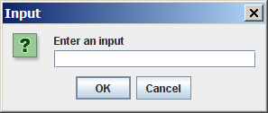
Using Input Dialog Boxes (1)
String input = JOptionPane.showInputDialog(
"Enter an input");

Slide 2
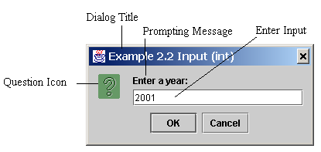
Using Input Dialog Boxes (2)
String string = JOptionPane.showInputDialog(
null, “Prompting Message”, “Dialog Title”,
JOptionPane.QUESTION_MESSAGE);

Slide 3
Two Ways to Invoke the Method
Method 1
String string = JOptionPane.showInputDialog(null,
x, y, JOptionPane.QUESTION_MESSAGE);
where x is a string for the prompting message, and y is a string for the title of the input dialog box.
Method 2
String string = JOptionPane.showInputDialog(x);
where x is a string for the prompting message.

Slide 4
Converting Strings to Integers
The input returned from the input dialog box is a string.
Eg: String input= JOptionPane.showInputDialog
("Enter an integer");
  If you enter a numeric value such as 123, it returns “123”.
To obtain the input as a number, you have to convert a string into a number.
To convert a string into an int value, use the static parseInt method in the Integer class as follows:
  int intValue = Integer.parseInt(input);
where input is a numeric string such as “123”.

Slide 5
Converting Strings to Doubles
To convert a string into an double value, use the static parseDouble method in the Double class as follows:
  String dblString = “123.456”;
  double dblValue;
  dblValue = Double.parseDouble(dblString);
TestJOptionPane.java

Slide 6
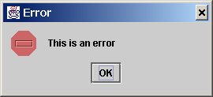
Message Dialogs
A message dialog box simply displays a message to alert the user and waits for the user to click the OK button to close the dialog.
JOptionPane.showMessageDialog(null, “This is an error",
“Error", JOptionPane.INFORMATION_MESSAGE);

Slide 7
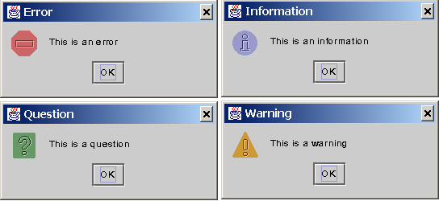
Message Types
The messageType is one of the following constants:
  JOptionPane.ERROR_MESSAGE
  JOptionPane.INFORMATION_MESSAGE
  JOptionPane.PLAIN_MESSAGE
  JOptionPane.WARNING_MESSAGE
  JOptionPane.QUESTION_MESSAGE

Slide 8
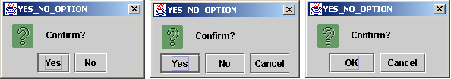
Confirmation Dialogs
A confirmation dialog asks a question and requires the user to respond with an appropriate button. The confirmation dialog returns a value that corresponds to a selected button.

Slide 9
Confirmation Dialogs
int option = JOptionPane.showConfirmDialog(null, Confirm?", “YES_NO_OPTION", JOptionPane.YES_NO_CANCEL_OPTION);
If (option == JOptionPane.YES_OPTION)
……

